Slide 1



Antivirus Software
Presented By
Vinita Rawat

Slide 2
Contents
Introduction
Virus and It’s Types
What are Anti –Virus Software
Types and Working of Antivirus Software
Advantages and Disadvantages

Slide 3

Introduction
An Antivirus Software is defined as a software used to prevent, detect and remove all sorts of malware such as Computer Viruses, Hijackers, Trojan Horses, etc.
Viruses can cause a lot of damage to a computer, including deleting files, corrupting data, or even crashing the computer. Antivirus Software helps to protect the computer from these threats. It scans the system for viruses and then delete or quarantine the infected files.

Slide 4

Viruses
And It’s Types
A computer virus is a malicious program, which when executed, replicates itself and inserts its own code. When the replication is done, the code infects the other files and program present on the system.
This ultimately results in data leak and crashing of the system.
Some Major Types Of Viruses :
Boot Sector Virus
Direct Action Virus
Multipartite Virus
Polymorphic Virus
Resident Virus
File Infector Virus

Slide 5
The Most Common Malicious Program

Slide 6
What are Antivirus Software
Antivirus Software is a class of applications that protect computers and remove malicious software or code designed to damage computers or data.
Once installed, most antivirus software runs automatically in the background to provide real time protection against virus attacks.
Comprehensive Virus Protection Programs help protect your files and hardware from malware such as worms, trojan horses and spyware and may also offer additional protection such as customizable firewalls and website blocking.

Slide 7

Types Of Antivirus Software
Free Antivirus Software
Paid Antivirus Software
Examples :
Avira
Bitdefender
Avast
AVG
Microsoft Defender
Examples :
Norton 360
McAfee
Kaspersky
ESET
Webroot

Slide 8
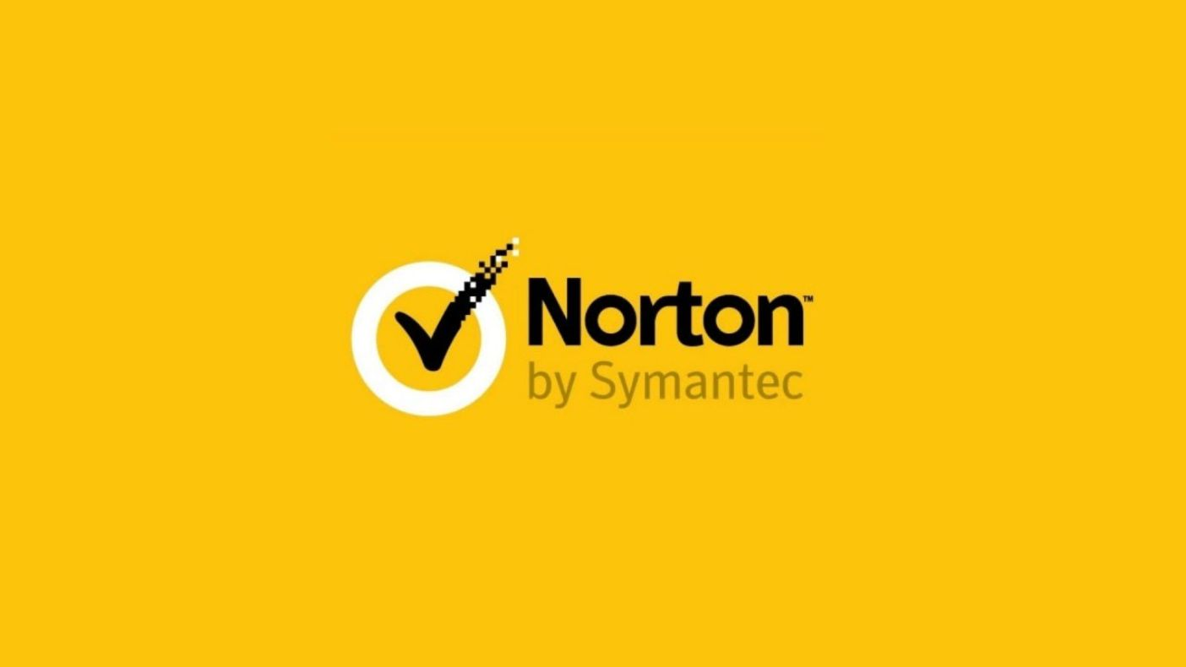



Popular Antivirus Software
Norton 360
AVG
Paid
Free
Avast
McAfee
Free
Paid

Slide 9
Working Methods Of Antivirus Software
Heuristics
Customizable Firewalls
Used to detect single Virus having ability to change into variants.
Detect unusual web activity and filter harmful online actions
Signature Based Tools
Searches for Virus Signatures
Root Kit Detection
Real Time Protection
Detect Root Kit malware
Helps in Background Guard, Auto protect, Website Testing

Slide 10

Advantages Of Antivirus Software :
Protection from Malware.
Protection from Viruses.
Protection from Spyware and Identity Theft.
Protection from Spam.
Protection of computer files.
Customizable Firewalls.
Real Time Protection.
Protects from Harmful Web Activity.

Slide 11

Disadvantages Of Antivirus Software :
System Slowdown
No Complete Protection
Security Holes
Limited Detection Techniques
Frequent Advertisements
No Customer Support

Slide 12




Thank you

